Slide 1
Acidic and Basic Solutions

Slide 2
Bell Work
Define the following terms:
Solubility
Heterogeneous vs. Homogenous
Crystallization vs. Precipitation
Solute vs. Solvent

Slide 3
Acids
Acids: substances that release positively charged Hydrogen ions.
This positive charges hydrogen molecule combines with a water molecule to create a Hydronium ion.

Slide 4
Acidic Solutions
Properties of Acids:
Sour taste
Conduct electricity
Batteries contain acid!
Corrode (Leave holes) fabric, skin, and paper.

Slide 5
Acidic Solutions
Uses of acids?

Slide 6
Acidic Solutions
Uses:
Food items: salad dressing, lemon, limes, oranges.
Products: Paint, fertilizers, plastics
Environment: Cave formation, acid rain
Beautiful Cave formations:
https://youtu.be/IKZ9EHewjZg

Slide 7
Basic Solutions
Bases: are substances that accept hydrogen ions
When dissolved in water, most bases leave behind a negatively charged Hydroxide ion. (OH-)

Slide 8
Basic Solutions
Properties of Bases:
Most Soaps are Basic
Feel Slippery
Bitter taste
Also corrosive and can cause burns and damage tissue
Can also conduct electricity
However, Basic solutions are not reactive with metals like acids!

Slide 9
Basic Solutions
Uses of Bases??

Slide 10
Uses of Basic Solutions
Soaps and Cleaning Products
Chalk
Treat lawns and Soil

Slide 11
Bell Work
Compare and Contrast Acids and Bases

Slide 12
What is pH?
pH is a measure of how acidic or basic a substance/solution is.
pH Scale:

Slide 13
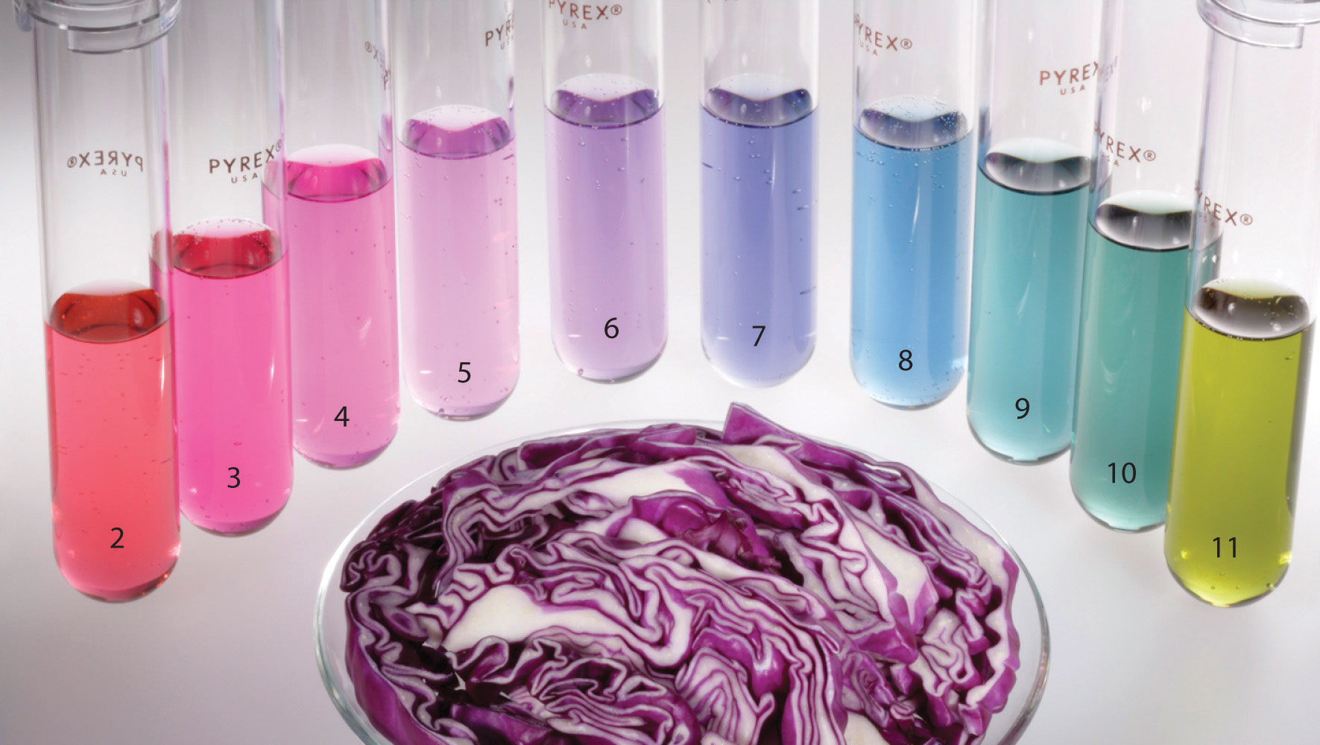
Indicators
Indicators: Compounds that react with acid and base solutions and produce certain colors, depending on the solutions pH.
Examples: Ph Strips & Concentrated Cabbage Juice ☺

Slide 14
Neutralization
How could you use the idea of pH to answer the following question:
If you spill a very dangerous acid on the floor how could you safely clean it up?

Slide 15
Neutralization
You combine an acid and a basic solution to become more neutral
Ex: HCl Acid (0) you would mix it with (14) to make a (7) Neutral.

Slide 17
Practice what you learned
pH sorting Activity

Slide 19
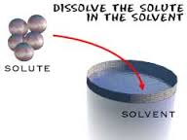
Solute -vs -Solvent
Simple solutions are basically two substances that are evenly mixed together.
A solute is the substance to be dissolved (sugar). The solvent is the one doing the dissolving (water).

Slide 20
Name the solute and solvents in the following examples …
Solution | Solute | Solvent
Lemonade
Coffee and cream
Tea
KoolAid
Ocean water

